Slide 1


Top Discriminator Efficiencies and Signal Over Bkg for several selection Categories NTUA
Giannis Papakrivopoulos
George Bakas

Slide 2
Overview
Efficiencies vs mTTbarParton
Signal over Background for
Mtt samples over Bkg
Nominal sample over Bkg
Yields for all samples
All Signal over Bkg are vs mJJ
Categories:
1. Both jets are top tagged and b tagged
2. 1 Jet top and b tagged and other jet top tagged
3. 1 Jet top and b tagged and other jet b tagged
4. Both jets are top tagged
5. Both jets are b tagged
Cuts:
Reco:
nJets > 1,
|jetEta| < 2.4 (both jets)
jetPt > 400 GeV (both jets)
120 GeV < jetMassSoftDrop < 220 GeV (both jets)
Parton:
|etaParton| < 2.4 (both partons)
ptTopParton > 400 GeV (both partons)
mTTbarParton > 1000

Slide 3
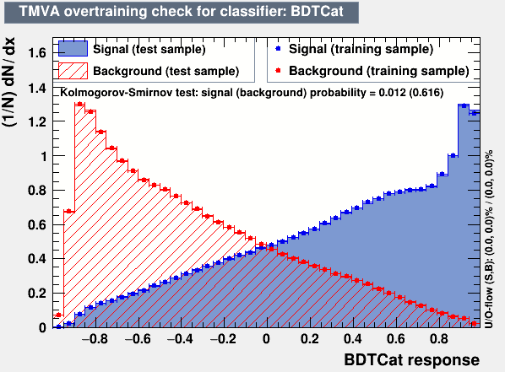
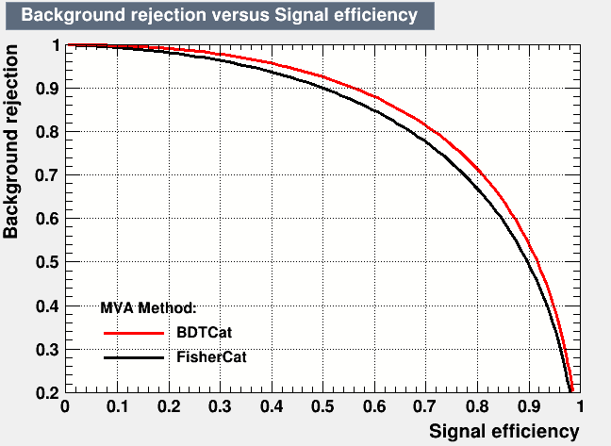
Training

Slide 4
Efficiency vs mTTbarParton
Top tagger cut : 0.0
B-tagging: Loose working point
nominal TT_TuneCUETP8M2T4_13TeV-powherg-pythia8
Mtt Samples

Slide 5
Efficiency vs mTTbarParton
Top tagger cut : 0.1
B-tagging: Loose working point
nominal TT_TuneCUETP8M2T4_13TeV-powherg-pythia8
Mtt Samples

Slide 6
Efficiency vs mTTbarParton
Top tagger cut : 0.2
B-tagging: Loose working point
nominal TT_TuneCUETP8M2T4_13TeV-powherg-pythia8
Mtt Samples

Slide 7
Efficiency vs mTTbarParton
Top tagger cut : 0.3
B-tagging: Loose working point
nominal TT_TuneCUETP8M2T4_13TeV-powherg-pythia8
Mtt Samples

Slide 8
Efficiency vs mTTbarParton
Top tagger cut : 0.4
B-tagging: Loose working point
nominal TT_TuneCUETP8M2T4_13TeV-powherg-pythia8
Mtt Samples

Slide 9
Efficiency vs mTTbarParton
Top tagger cut : 0.6
B-tagging: Loose working point
nominal TT_TuneCUETP8M2T4_13TeV-powherg-pythia8
Mtt Samples

Slide 10
Efficiency vs mTTbarParton
Top tagger cut : 0.6
B-tagging: Loose working point
nominal TT_TuneCUETP8M2T4_13TeV-powherg-pythia8
Mtt Samples

Slide 11
Efficiency vs mTTbarParton
Top tagger cut : 0.7
B-tagging: Loose working point
nominal TT_TuneCUETP8M2T4_13TeV-powherg-pythia8
Mtt Samples

Slide 12
Efficiency vs mTTbarParton
Top tagger cut : 0.8
B-tagging: Loose working point
nominal TT_TuneCUETP8M2T4_13TeV-powherg-pythia8
Mtt Samples

Slide 13
Efficiency vs mTTbarParton
Top tagger cut : 0.0
B-tagging: Medium working point
nominal TT_TuneCUETP8M2T4_13TeV-powherg-pythia8
Mtt Samples

Slide 14
Efficiency vs mTTbarParton
Top tagger cut : 0.1
B-tagging: Medium working point
nominal TT_TuneCUETP8M2T4_13TeV-powherg-pythia8
Mtt Samples

Slide 15
Efficiency vs mTTbarParton
Top tagger cut : 0.2
B-tagging: Medium working point
nominal TT_TuneCUETP8M2T4_13TeV-powherg-pythia8
Mtt Samples

Slide 16
Efficiency vs mTTbarParton
Top tagger cut : 0.3
B-tagging: Medium working point
nominal TT_TuneCUETP8M2T4_13TeV-powherg-pythia8
Mtt Samples

Slide 17
Efficiency vs mTTbarParton
Top tagger cut : 0.4
B-tagging: Medium working point
nominal TT_TuneCUETP8M2T4_13TeV-powherg-pythia8
Mtt Samples

Slide 18
Efficiency vs mTTbarParton
Top tagger cut : 0.6
B-tagging: Medium working point
nominal TT_TuneCUETP8M2T4_13TeV-powherg-pythia8
Mtt Samples

Slide 19
Efficiency vs mTTbarParton
Top tagger cut : 0.7
B-tagging: Medium working point
nominal TT_TuneCUETP8M2T4_13TeV-powherg-pythia8
Over Bkg (All Categories)
Mtt Samples

Slide 20
Efficiency vs mTTbarParton
Top tagger cut : 0.8
B-tagging: Medium working point
nominal TT_TuneCUETP8M2T4_13TeV-powherg-pythia8
Mtt Samples

Slide 21
Signal over Bkg for mJJ (reco)
Top tagger cut : 0.0
B-tagging: Loose working point
nominal TT_TuneCUETP8M2T4_13TeV-powherg-pythia8
Over Bkg (All Categories)
Mtt Samples

Slide 22
Signal over Bkg for mJJ (reco)
Top tagger cut : 0.1
B-tagging: Loose working point
nominal TT_TuneCUETP8M2T4_13TeV-powherg-pythia8
Over Bkg (All Categories)
Mtt Samples

Slide 23
Signal over Bkg for mJJ (reco)
Top tagger cut : 0.2
B-tagging: Loose working point
nominal TT_TuneCUETP8M2T4_13TeV-powherg-pythia8
Over Bkg (All Categories)
Mtt Samples

Slide 24
Signal over Bkg for mJJ (reco)
Top tagger cut : 0.3
B-tagging: Loose working point
nominal TT_TuneCUETP8M2T4_13TeV-powherg-pythia8
Over Bkg (All Categories)
Mtt Samples

Slide 25
Signal over Bkg for mJJ (reco)
Top tagger cut : 0.4
B-tagging: Loose working point
nominal TT_TuneCUETP8M2T4_13TeV-powherg-pythia8
Over Bkg (All Categories)
Mtt Samples

Slide 26
Signal over Bkg for mJJ (reco)
Top tagger cut : 0.6
B-tagging: Loose working point
nominal TT_TuneCUETP8M2T4_13TeV-powherg-pythia8
Over Bkg (All Categories)
Mtt Samples

Slide 27
Signal over Bkg for mJJ (reco)
Top tagger cut : 0.7
B-tagging: Loose working point
nominal TT_TuneCUETP8M2T4_13TeV-powherg-pythia8
Over Bkg (All Categories)
Mtt Samples

Slide 28
Signal over Bkg for mJJ (reco)
Top tagger cut : 0.8
B-tagging: Loose working point
nominal TT_TuneCUETP8M2T4_13TeV-powherg-pythia8
Over Bkg (All Categories)
Mtt Samples

Slide 29
Signal over Bkg for mJJ (reco)
Top tagger cut : 0.0
B-tagging: Medium working point
nominal TT_TuneCUETP8M2T4_13TeV-powherg-pythia8
Over Bkg (All Categories)
Mtt Samples

Slide 30
Signal over Bkg for mJJ (reco)
Top tagger cut : 0.1
B-tagging: Medium working point
nominal TT_TuneCUETP8M2T4_13TeV-powherg-pythia8
Over Bkg (All Categories)
Mtt Samples

Slide 31
Signal over Bkg for mJJ (reco)
Top tagger cut : 0.2
B-tagging: Medium working point
nominal TT_TuneCUETP8M2T4_13TeV-powherg-pythia8
Over Bkg (All Categories)
Mtt Samples

Slide 32
Signal over Bkg for mJJ (reco)
Top tagger cut : 0.3
B-tagging: Medium working point
nominal TT_TuneCUETP8M2T4_13TeV-powherg-pythia8
Over Bkg (All Categories)
Mtt Samples

Slide 33
Signal over Bkg for mJJ (reco)
Top tagger cut : 0.4
B-tagging: Medium working point
nominal TT_TuneCUETP8M2T4_13TeV-powherg-pythia8
Over Bkg (All Categories)
Mtt Samples

Slide 34
Signal over Bkg for mJJ (reco)
Top tagger cut : 0.6
B-tagging: Medium working point
nominal TT_TuneCUETP8M2T4_13TeV-powherg-pythia8
Over Bkg (All Categories)
Mtt Samples

Slide 35
Signal over Bkg for mJJ (reco)
Top tagger cut : 0.7
B-tagging: Medium working point
nominal TT_TuneCUETP8M2T4_13TeV-powherg-pythia8
Over Bkg (All Categories)
Mtt Samples

Slide 36
Signal over Bkg for mJJ (reco)
Top tagger cut : 0.8
B-tagging: Medium working point
nominal TT_TuneCUETP8M2T4_13TeV-powherg-pythia8
Over Bkg (All Categories)
Mtt Samples

Slide 37
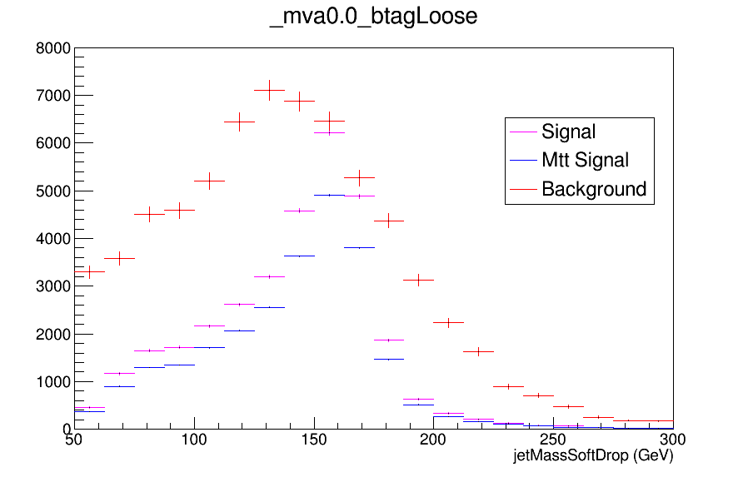
Expected Yields vs JetMassSoftDrop (double fill)

Slide 38
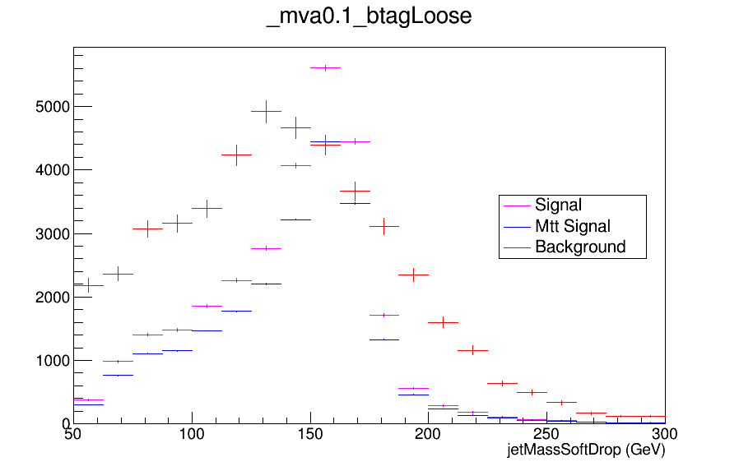
Expected Yields vs JetMassSoftDrop (double fill)

Slide 39
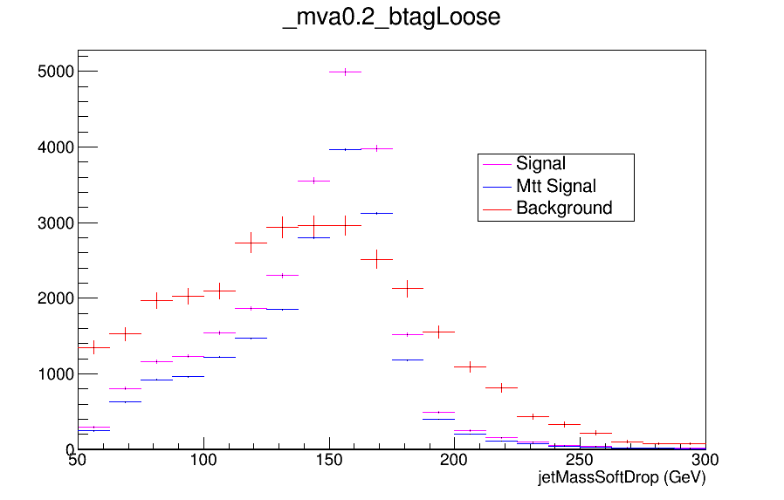
Expected Yields vs JetMassSoftDrop (double fill)

Slide 40
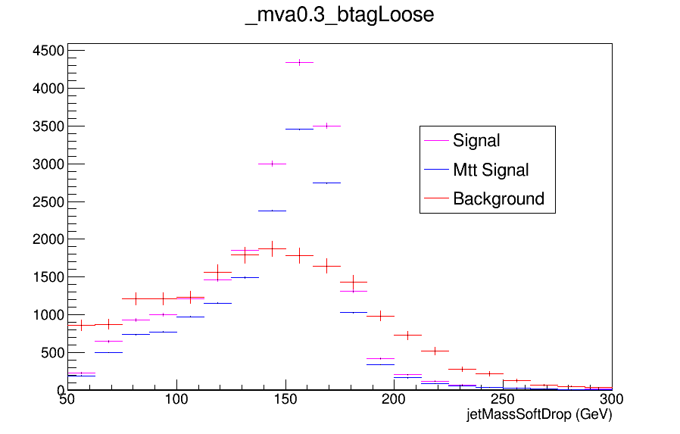
Expected Yields vs JetMassSoftDrop (double fill)

Slide 41
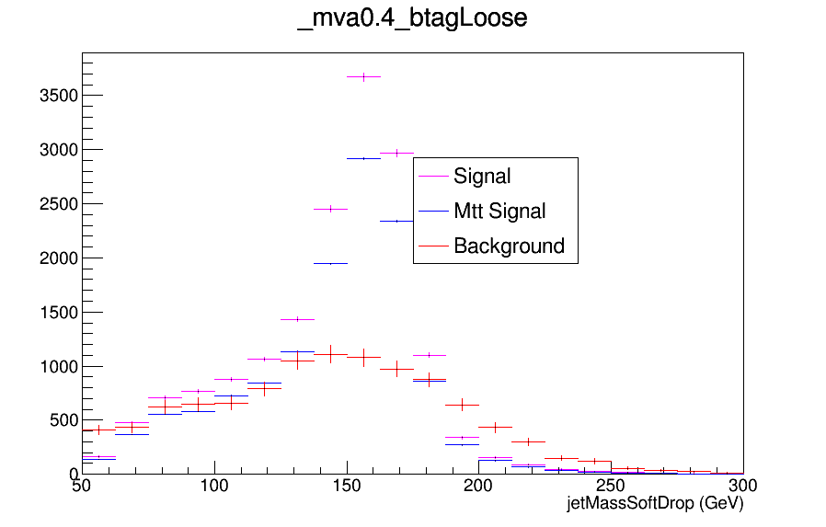
Expected Yields vs JetMassSoftDrop (double fill)

Slide 42
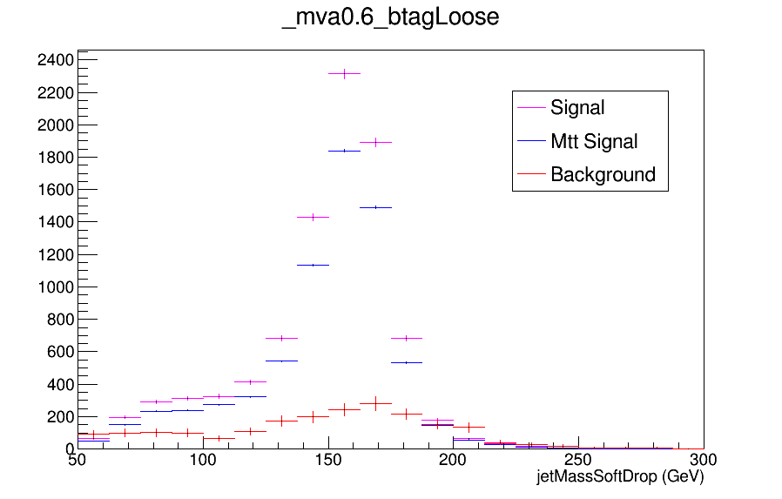
Expected Yields vs JetMassSoftDrop (double fill)

Slide 43
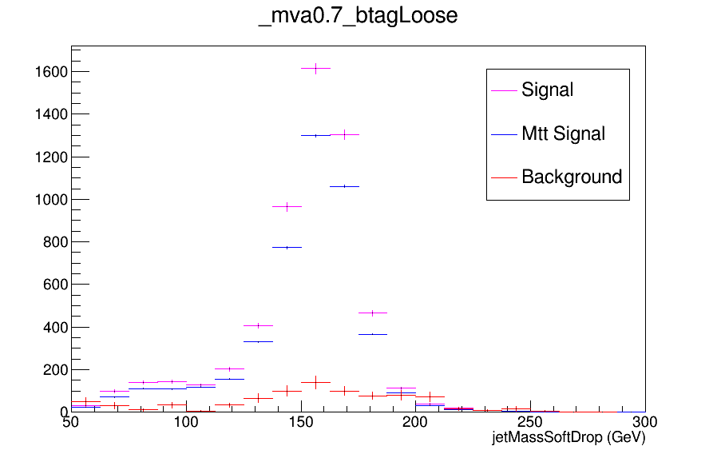
Expected Yields vs JetMassSoftDrop (double fill)

Slide 44

Expected Yields vs JetMassSoftDrop (double fill)

Slide 45
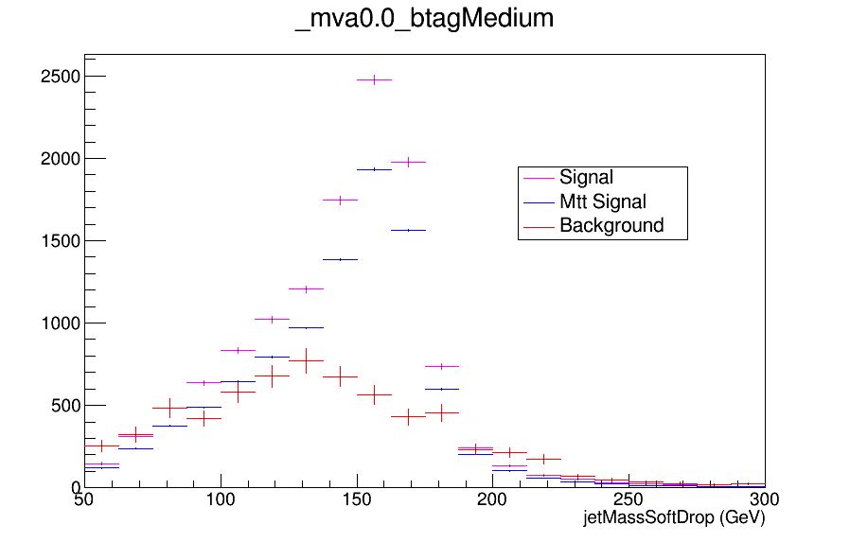
Expected Yields vs JetMassSoftDrop (double fill)

Slide 46
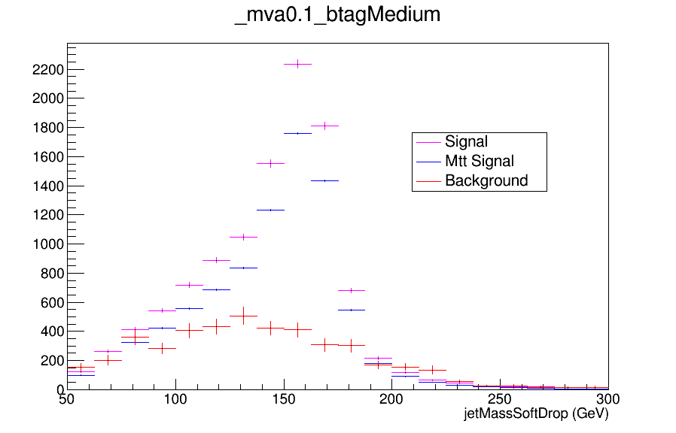
Expected Yields vs JetMassSoftDrop (double fill)

Slide 47
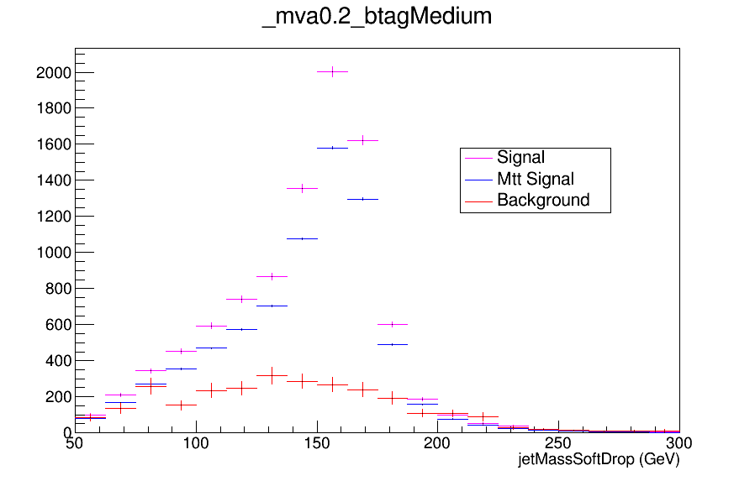
Expected Yields vs JetMassSoftDrop (double fill)

Slide 48
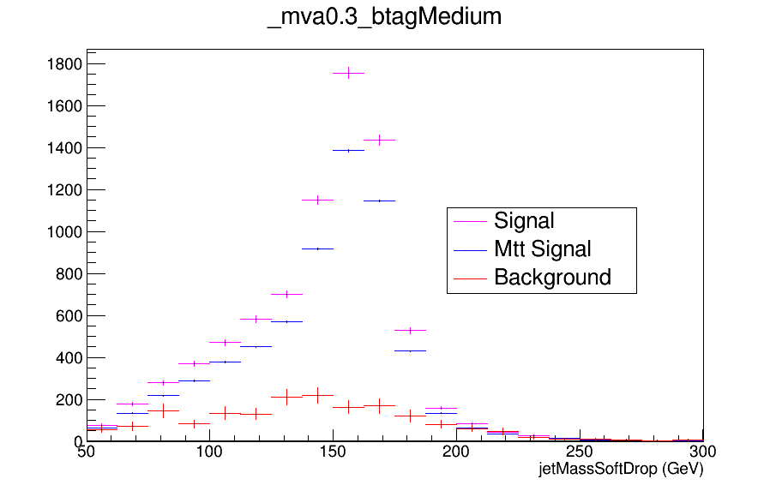
Expected Yields vs JetMassSoftDrop (double fill)

Slide 49
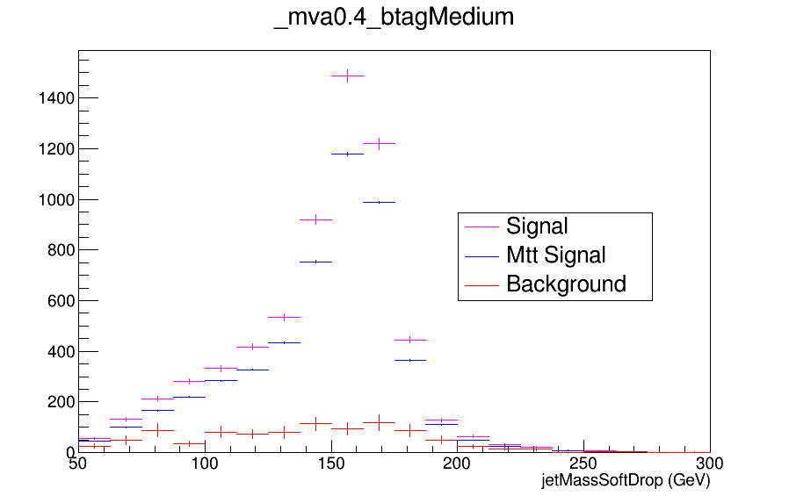
Expected Yields vs JetMassSoftDrop (double fill)

Slide 50
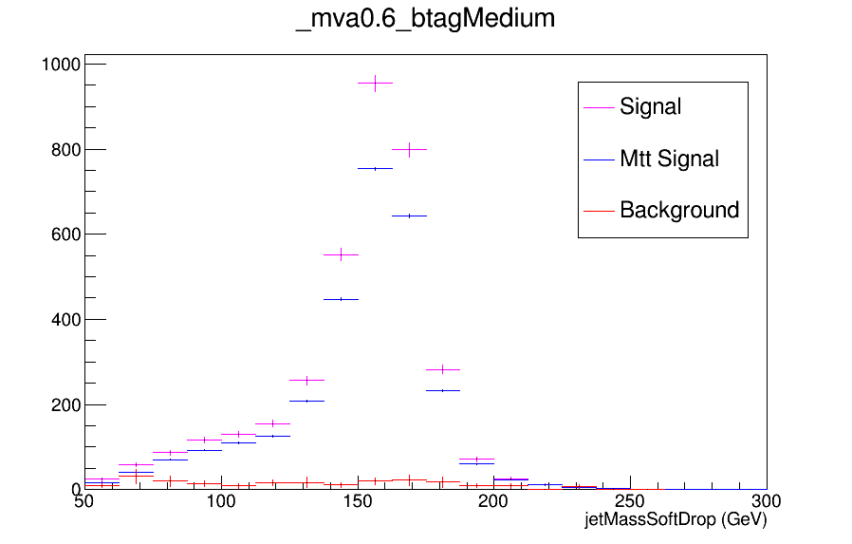
Expected Yields vs JetMassSoftDrop (double fill)

Slide 51

Expected Yields vs JetMassSoftDrop (double fill)

Slide 52
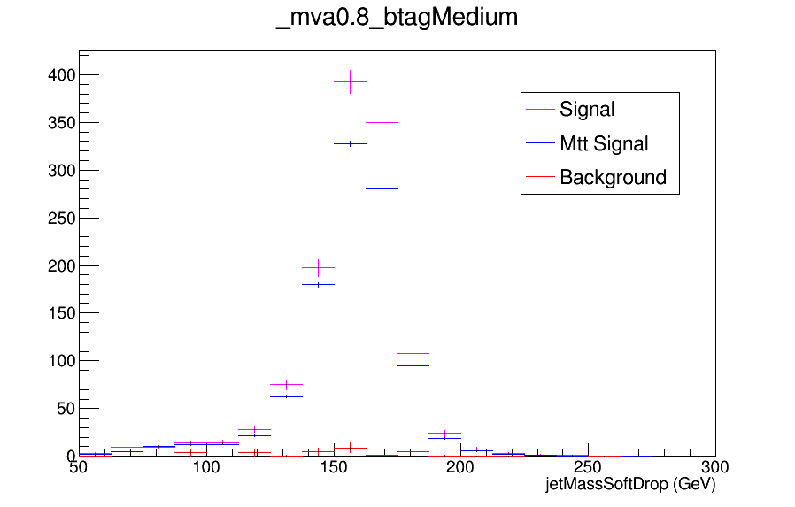
Expected Yields vs JetMassSoftDrop (double fill)

